Slide 1
Hypnos
CPE 309
Audrey Chan
Jonathan Chianglin
Natasha Cortez
Arjun Gupta
Andrew Ly
Elyse Munemura
1
Notes:
hi

Slide 2
Introduction
Andrew Ly - Worked on server, client, and the first level
Arjun Gupta - Worked on controls and mouse inputs
Audrey Chan - Worked on graphics, animations, and audio options.
Elyse Munemura - Worked on menu and achievements
Jonathan Chianglin - Worked on login and create account
Natasha Cortez - Worked on server and database.
2

Slide 3
Outline
Demo
Design
Concept
Animation
Diagrams
Design Patterns
Design Decision Rationale
Development
Statistical Process Control Chart
Testing
Server
Conclusion
Questions
3
Notes:
hi

Slide 4
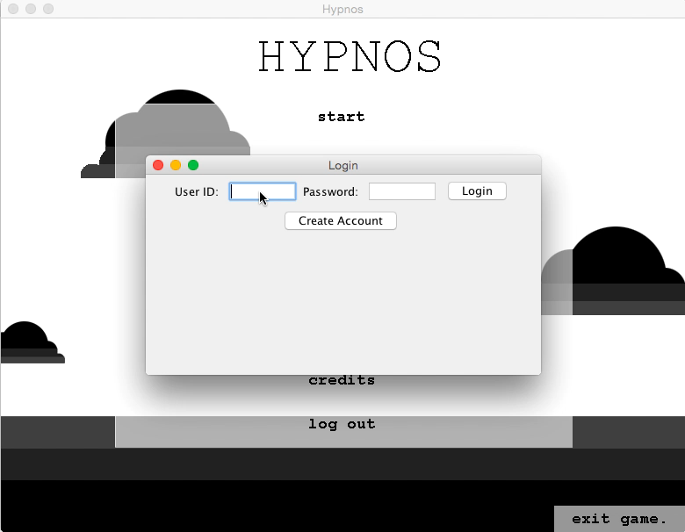
Demo
4

Slide 5
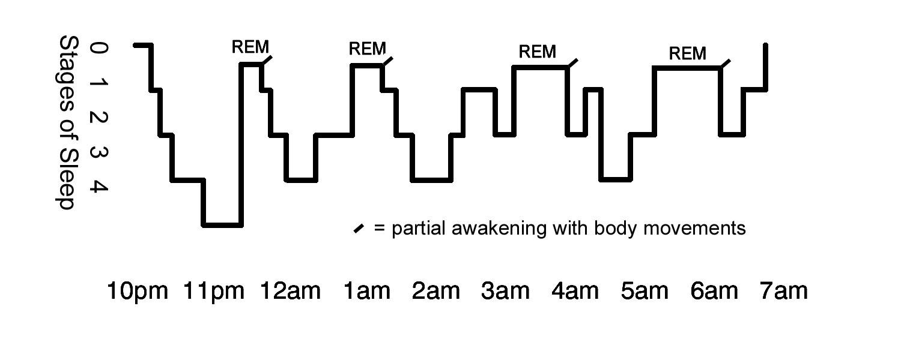



Design: Concept
Hypnos = Greek god of sleep
Game = Dream
Levels = Different stages of REM
Bosses = Nightmares
5

Slide 6
Design: Concept (cont.)
Endless runner
Platformer
Level 1
Level 2
...
Level 6
Final Boss
WIN
Boss 1
Boss 2
6

Slide 7
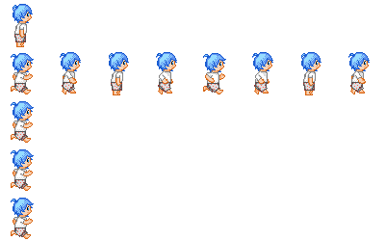
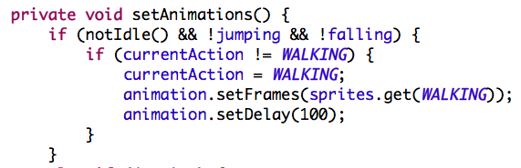
Design: Animation
BufferedImage arrays
FR: Four Actions
A: Idle
B: Running
C: Jumping
D: Falling
Animation.java
Player.java
A
B
C
D
7

Slide 8
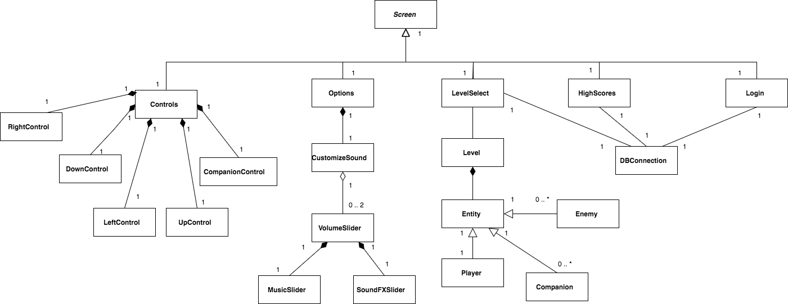
Design: Class Diagram
8

Slide 9
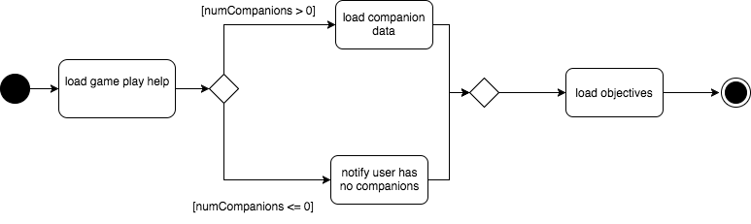
Design: Activity Diagram
9

Slide 10
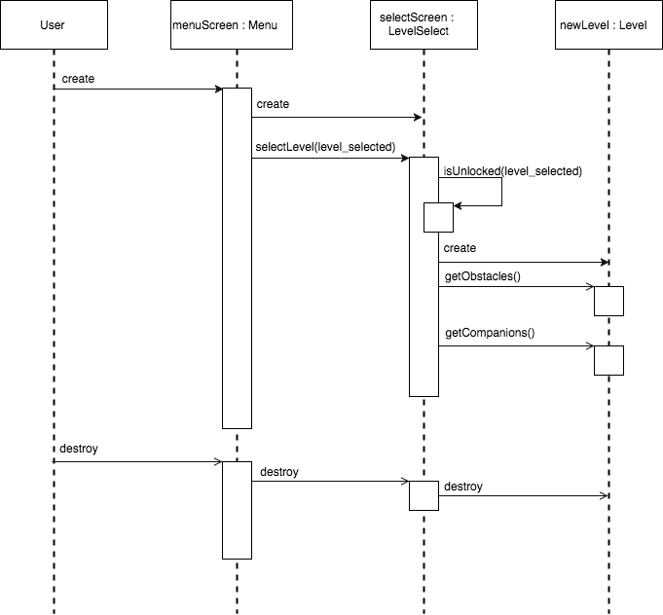
Design: Sequence Diagram
10

Slide 11
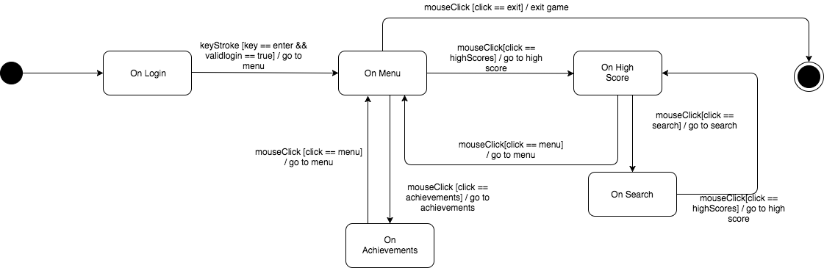
Design: State Diagram
11

Slide 12
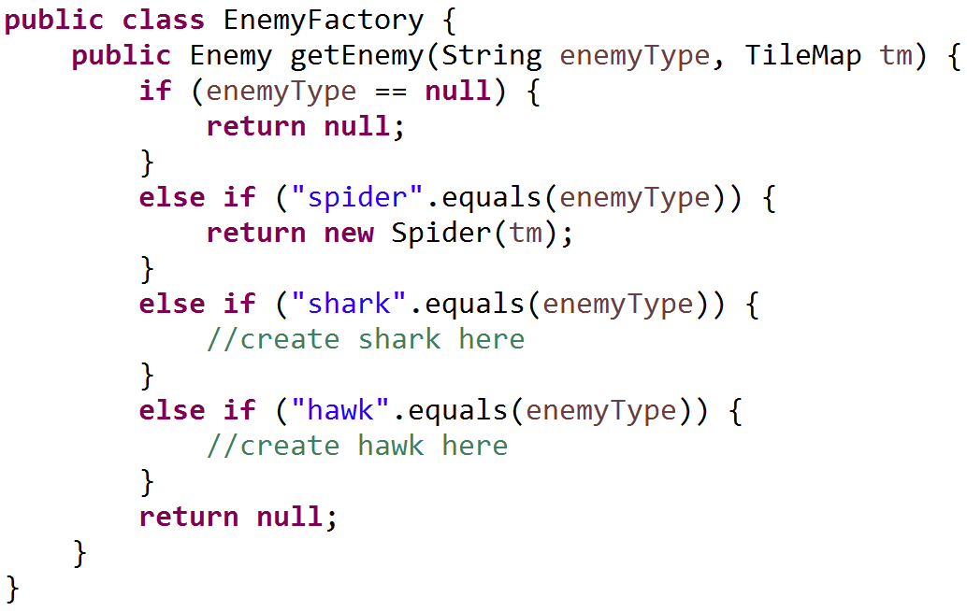
Design: Factory Pattern
Allows us to easily create and utilize enemies throughout the program
Lets everyone on the project handle enemies without needing to understand the enemy objects themselves
12

Slide 13
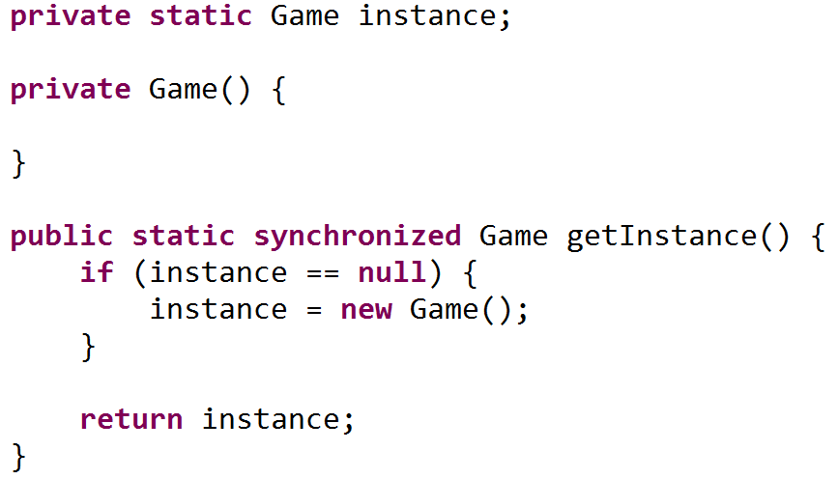
Design: Singleton Pattern
Only want one instance of the game running
Allows every screen, object, and database call to be tied to a single instantiation
Game cannot be static
13

Slide 14
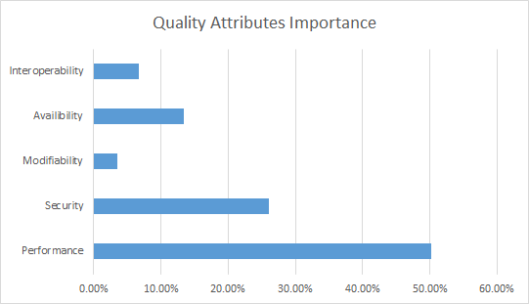
Design: Decisions Rationale
Performance: Smooth gameplay is priority
Security: Integrity of data and highscores
Availability: Audience as diverse as possible
Interoperability: Database is the only outside system
Modifiability: Do not intend to go back and make many changes
14

Slide 15
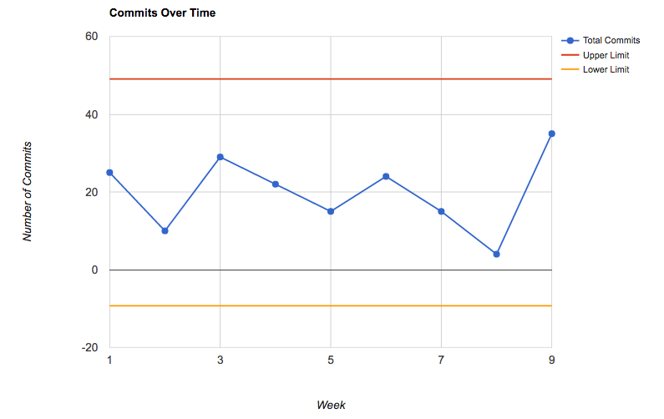
Dev: Statistical Process Chart
15

Slide 16
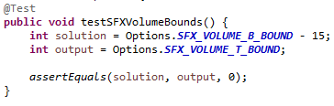
Dev: Unit Testing
Testing individual components
General tests on objects
16
Notes:
Unit Testing
GUI on Logging In and Creating Account
Check when launching GUI’s nothing is changed
Checking boundaries for enemies
Setting them at the boundaries

Slide 17
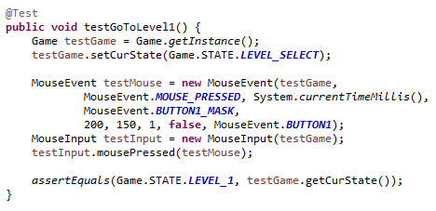
Dev: Integration Testing
Combination of the units
Testing components as group
17
Notes:
Integration Testing
Example
Creating game instance
Creating mouse event and mouseinput
Create the event
Essentially all the same
State of the game
Figuring the Java API

Slide 18
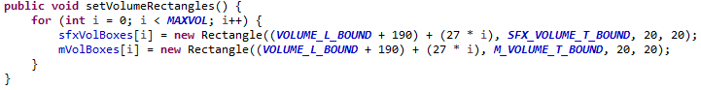
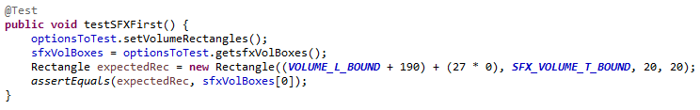
Dev: Loop Testing
Similar to Unit Testing
Covering certain cases
18
Notes:
Loop Testing (testing loops)
Arjun’s - loop to see if all rectangles of Volume bar are getting created
Mine - loop to see if the player collides with the enemies
Audrey’s - loop to see if system is tracking the character at the right frame
Other loops not testable because they are render methods and you cannot test for drawing (quantifiable way to check if a drawing is drawn besides just seeing it)

Slide 19
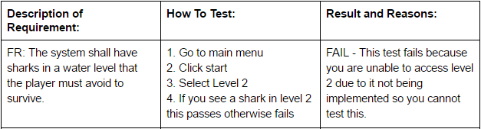
Dev: System Testing
Testable NFR
FR Requirements
19
Notes:
Unit Testing
GUI on Logging In and Creating Account
Check when launching GUI’s nothing is changed
Mouse Inputs going to the correct States
Check state
Giving a character a X/Y coordinate and checking if it’s on the screen
Checking boundaries for enemies
Setting them at the boundaries
Integration Testing
Essentially all the same
Loop Testing (testing loops)
Other loops not testable because they are render methods and you cannot test for drawing (quantifiable way to check if a drawing is drawn besides just seeing it)
Arjun’s - loop to see if all rectangles of Volume bar are getting created
Mine - loop to see if the player collides with the enemies
Audrey’s - loop to see if system is tracking the character at the right frame
System Testing
NFR and FR Requirements

Slide 20
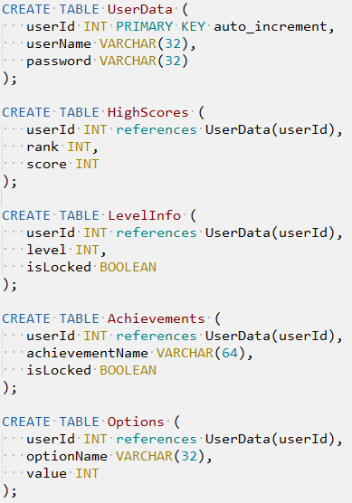
Dev: Server and Database
Server and client
The database
Database schema
Queries
Limitations
[picture here]
20

Slide 21
Conclusion
Current implementation
What we learned
What we would have changed
Future improvements
21

Slide 22
Questions?
22

